Slide 1
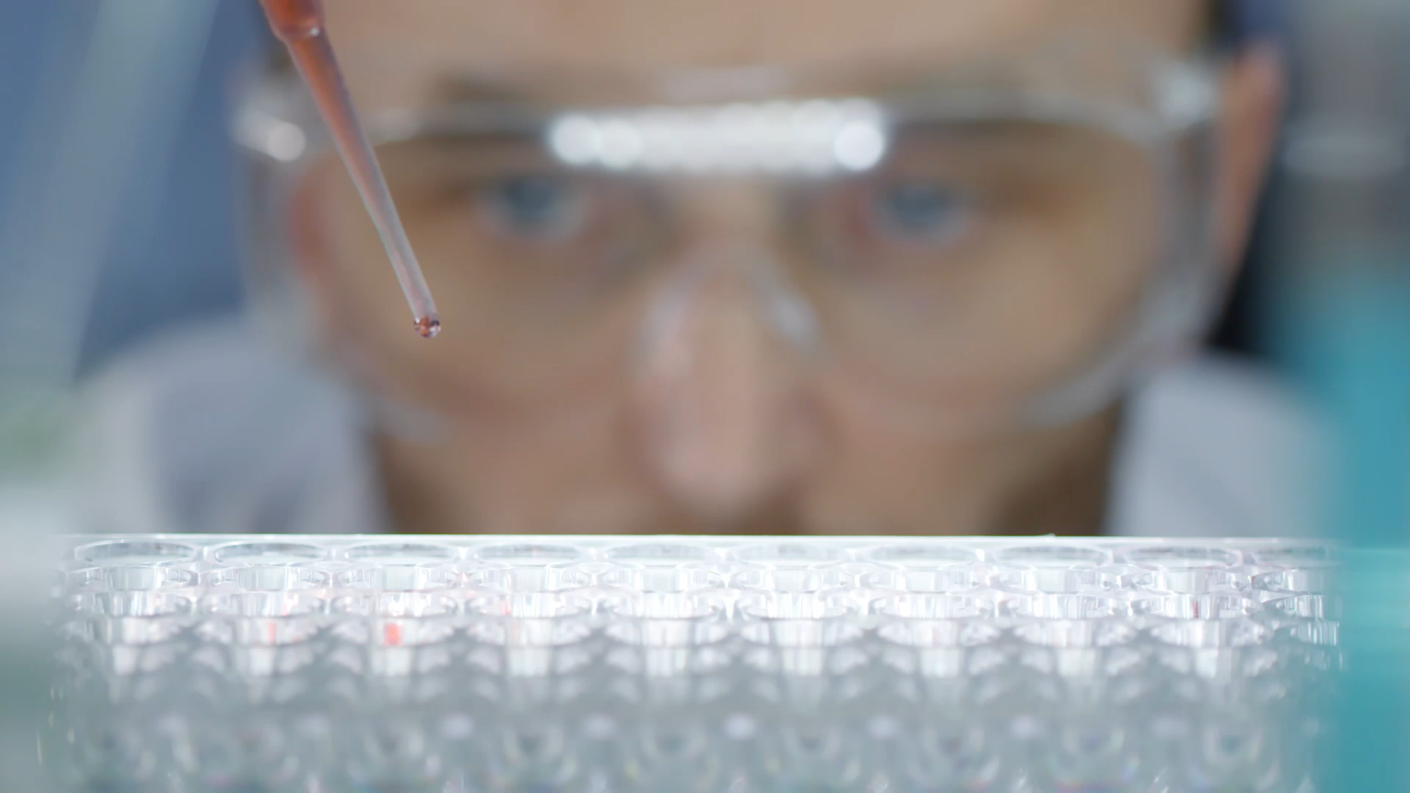
Drug Discovery Using ML models
By: Anupriya, Sanjana, Silmi, Manisha

Slide 2

Use Case
Healthcare industry generated almost 2000 exabytes of data in 2020 (1) and this number will keep increasing in upcoming years.
It is important for healthcare professionals to efficiently examine a patient data and diagnose them in a timely manner.
With the data boom, analyzing this data would be impossible without the help of Artificial Intelligence and applications of Machine Learning algorithms.

Slide 3
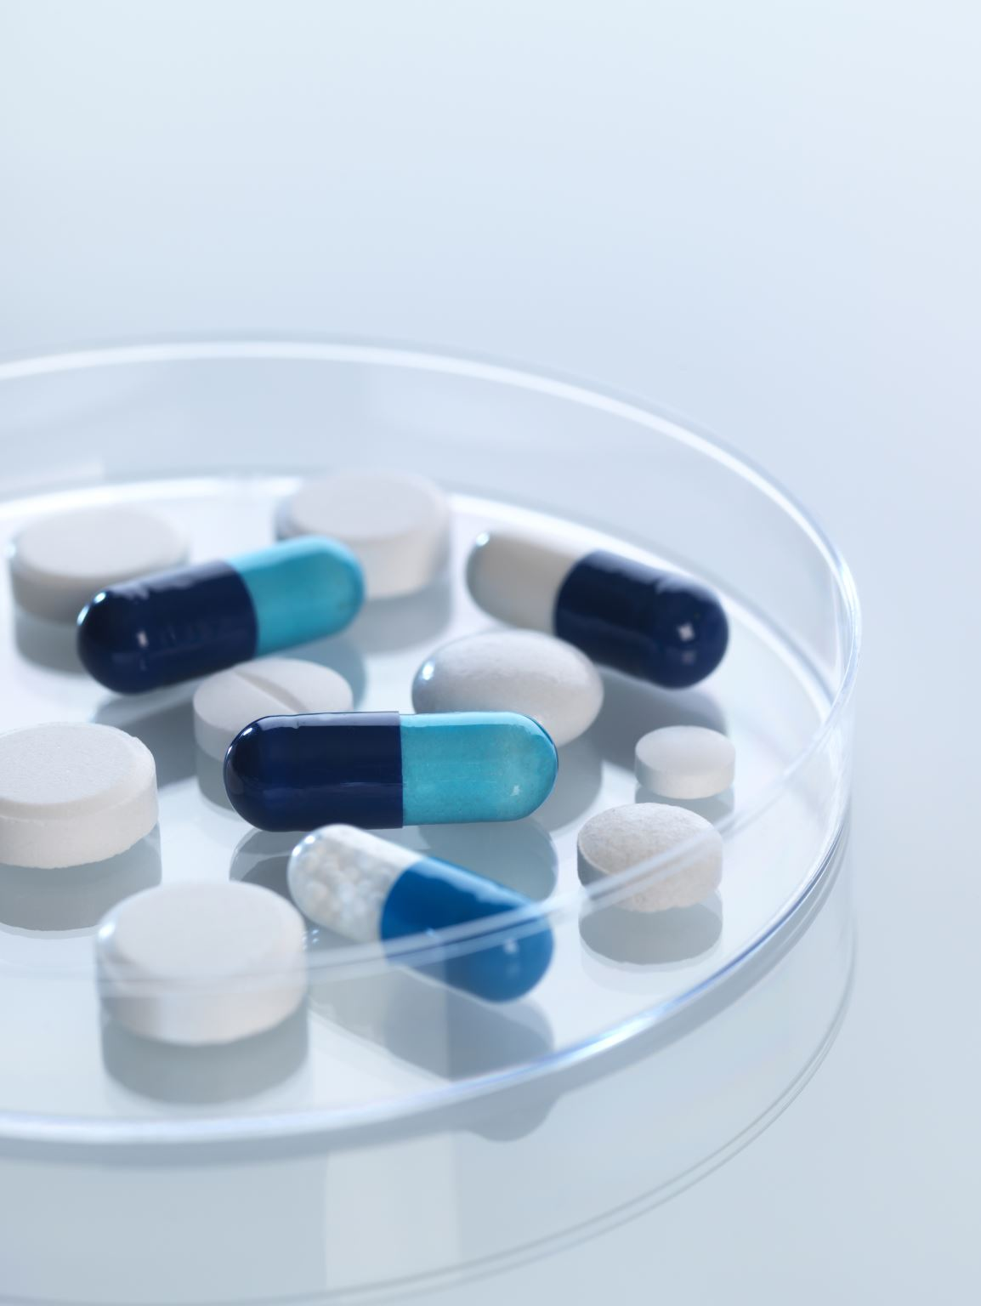
Use Case
In this project, we will be researching how AI can be implemented in the field of drug discovery.
This is an important topic because researchers and scientists need to constantly design and predict the efficiency of potential drug candidates to be manufactured and released for human use (2)

Slide 4

Data
We will obtain data from CHEMBL database.
This database contain information on chemical, bioactivity and genomic data.
Genomic information on this platform will be used to identify effective new drugs (3).
In this dataset, drugs are represented in SMILES strings

Slide 5
Processes
Data Collection
We will choose a target protein that affects a certain disease. For example, people with Alzheimer’s disease have a lower level of a protein called acetylcholinesterase than people without Alzheimer's disease.
2. Exploratory Data Analysis
We will then perform EDA on the pre-processed data. The most important aspect in this process will be the cleaning of the Simplified Molecular Input Line Entry System (SMILES) notation.
3. Descriptor Calculation
Calculation of individual components/ chemical structures.
4. Data Modelling
A random forest model will be built to perform prediction on quantitative data.

Slide 6
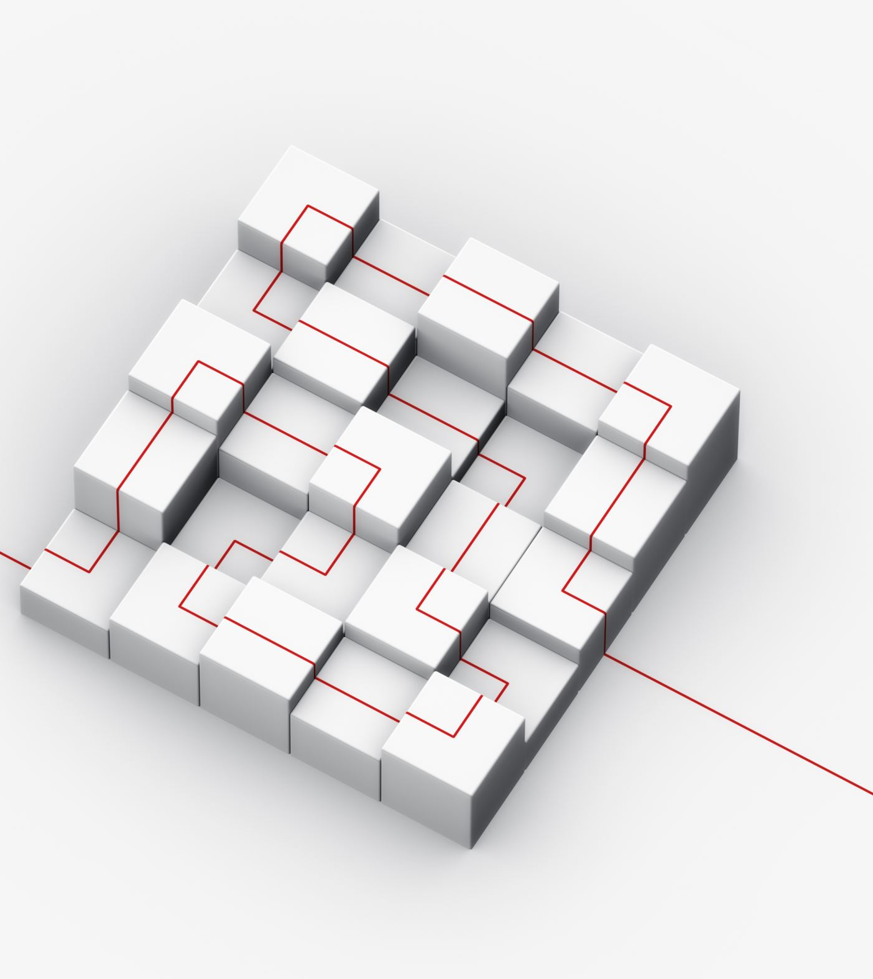
Processes
5. Model comparisons
The multiple models built on the above steps will be compared and represented in the performance comparison plot.
6. Model deployment
The model will be deployed in the form of a web application. The webpage will accommodate users to input their SMILES notation on the webpage and our algorithm will build the prediction and export the predicted results to users.

Slide 7
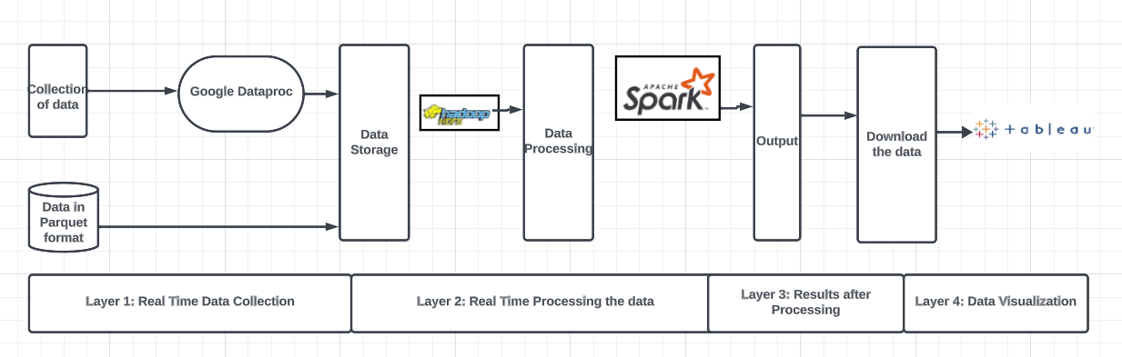
Big Data Architecture

Slide 8
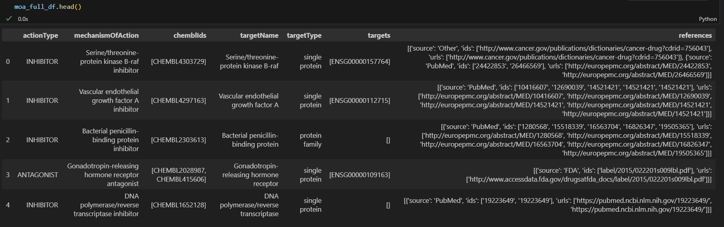
Mechanism of Action

Slide 9
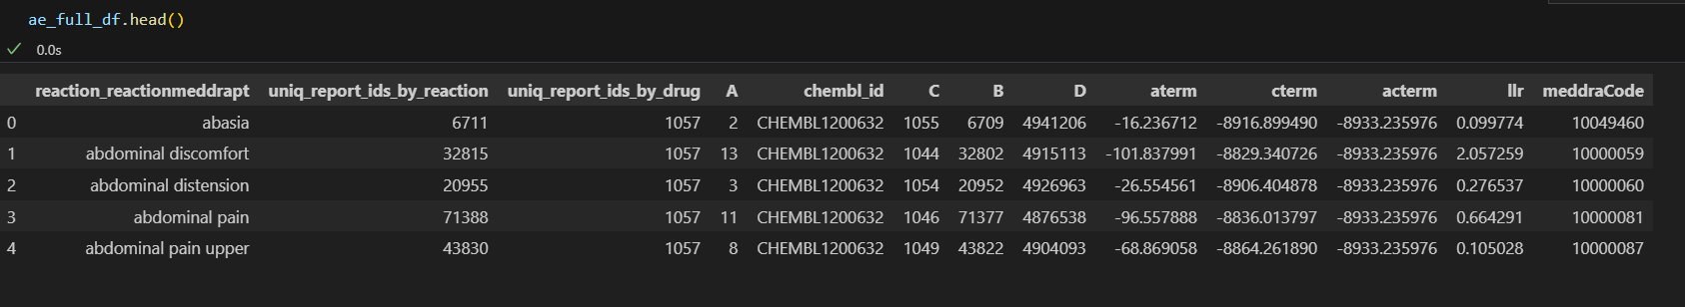
Adverse Events

Slide 10
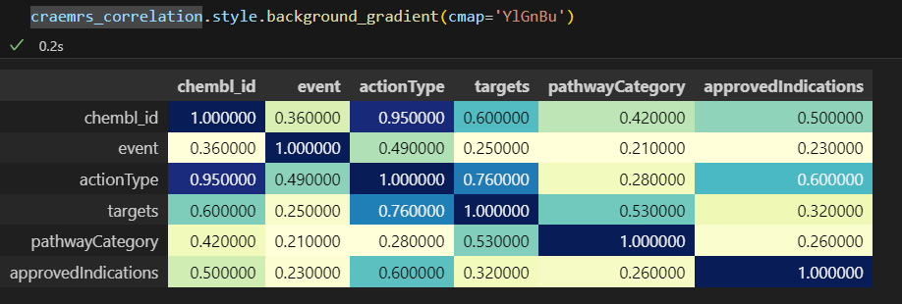
Correlation Heatmap

Slide 11
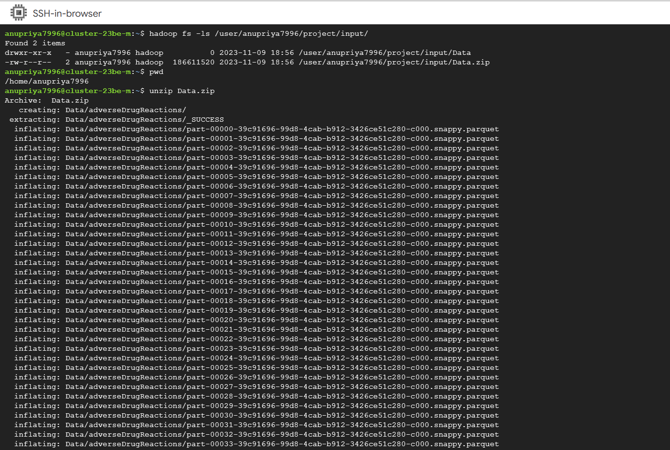
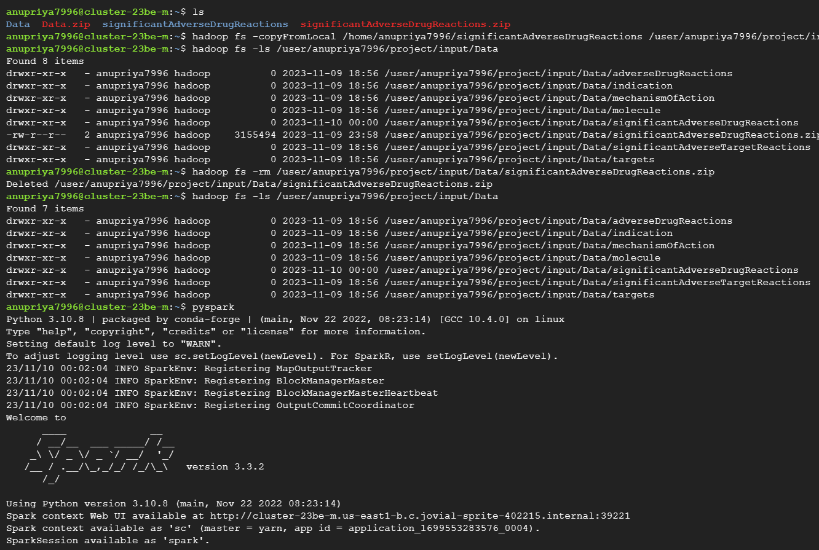
Hadoop, Spark

Slide 12
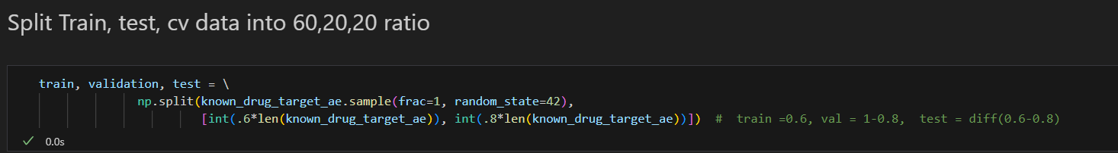
Split, Train, Test

Slide 13
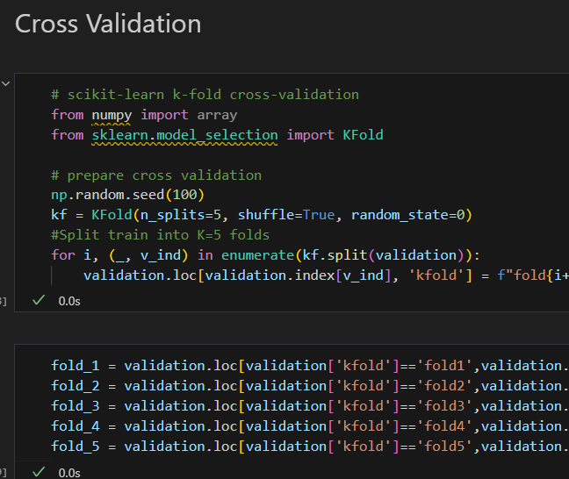
Cross Validation

Slide 14
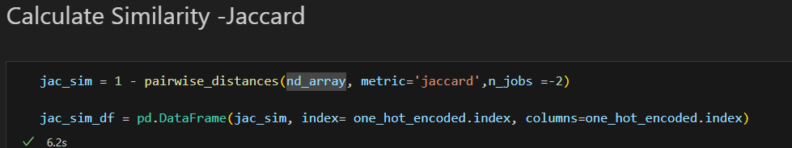
Jaccard Similarity Score

Slide 15
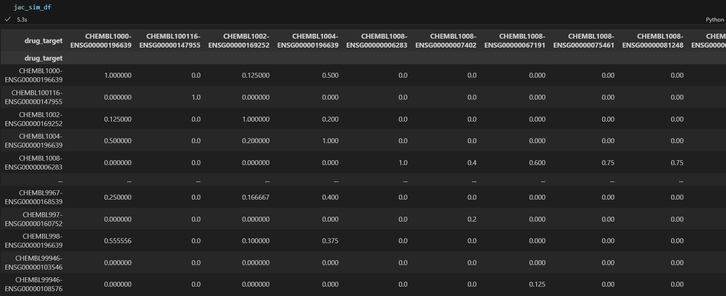
Results

Slide 16
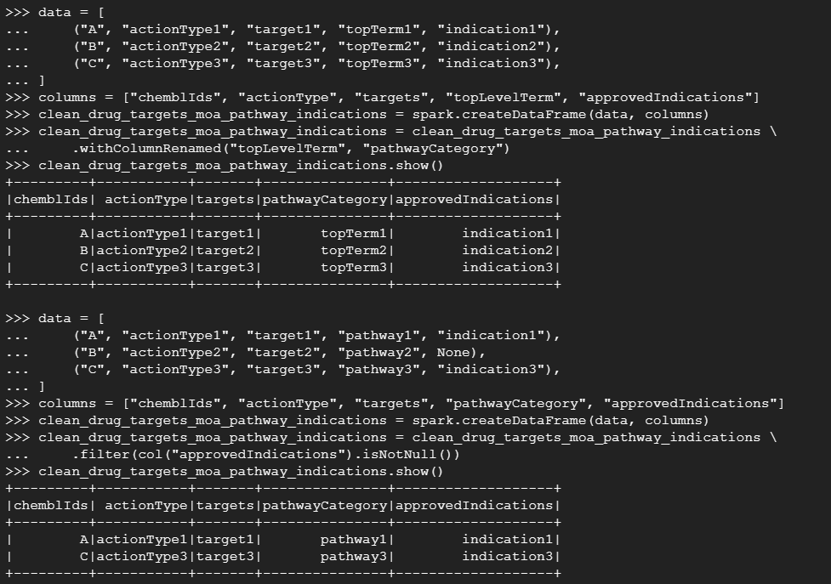
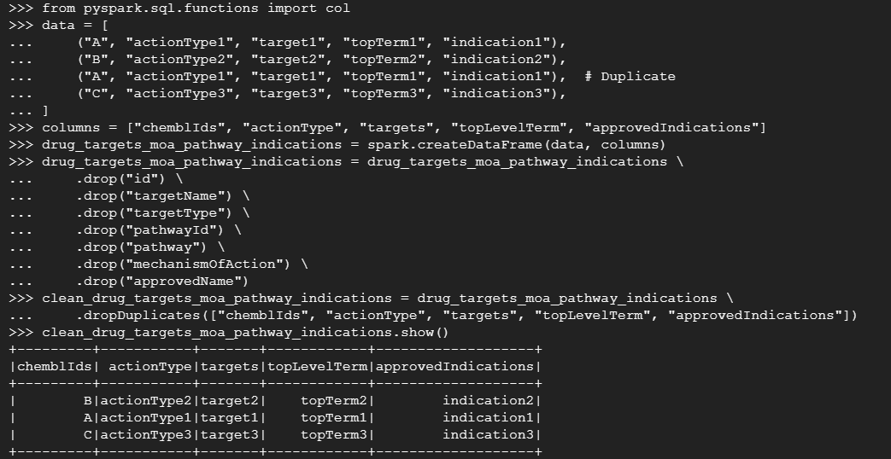

Slide 17
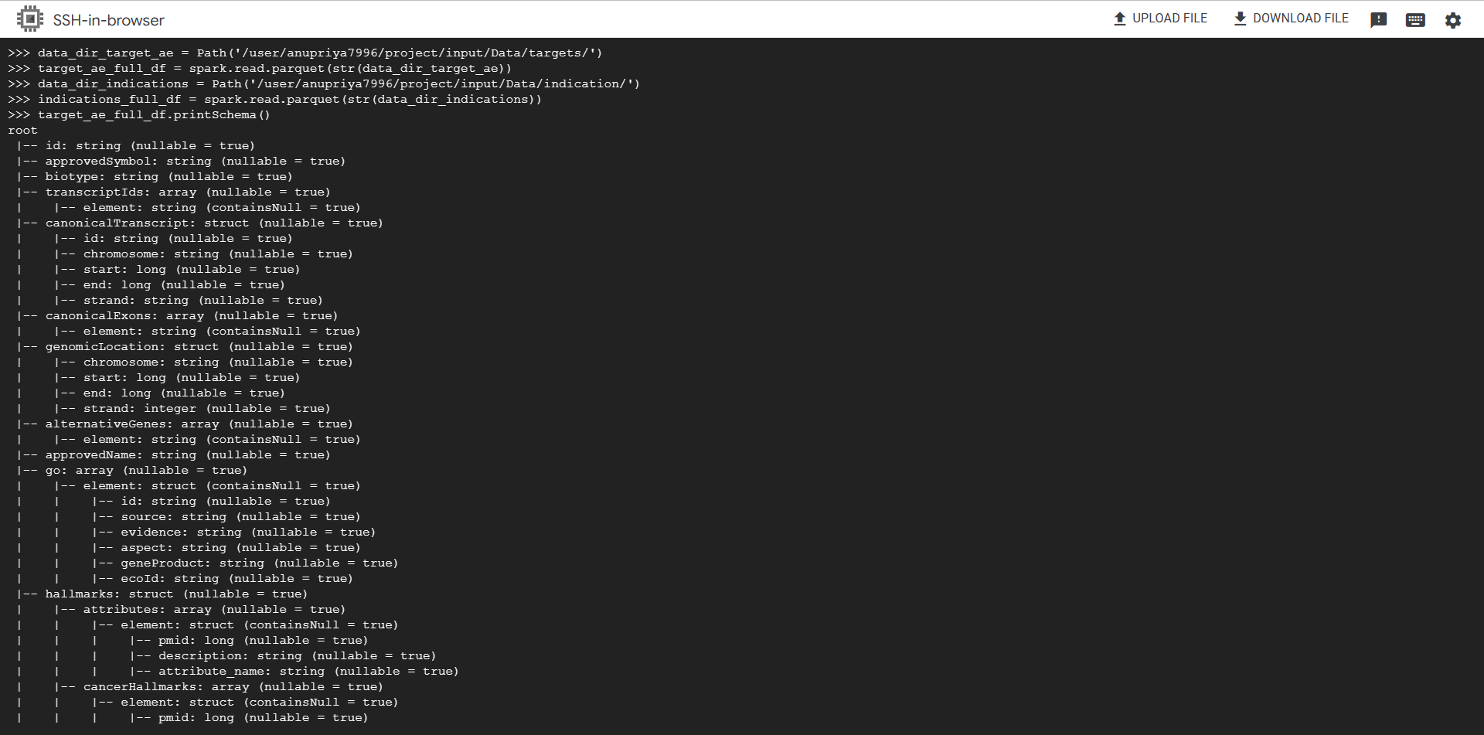
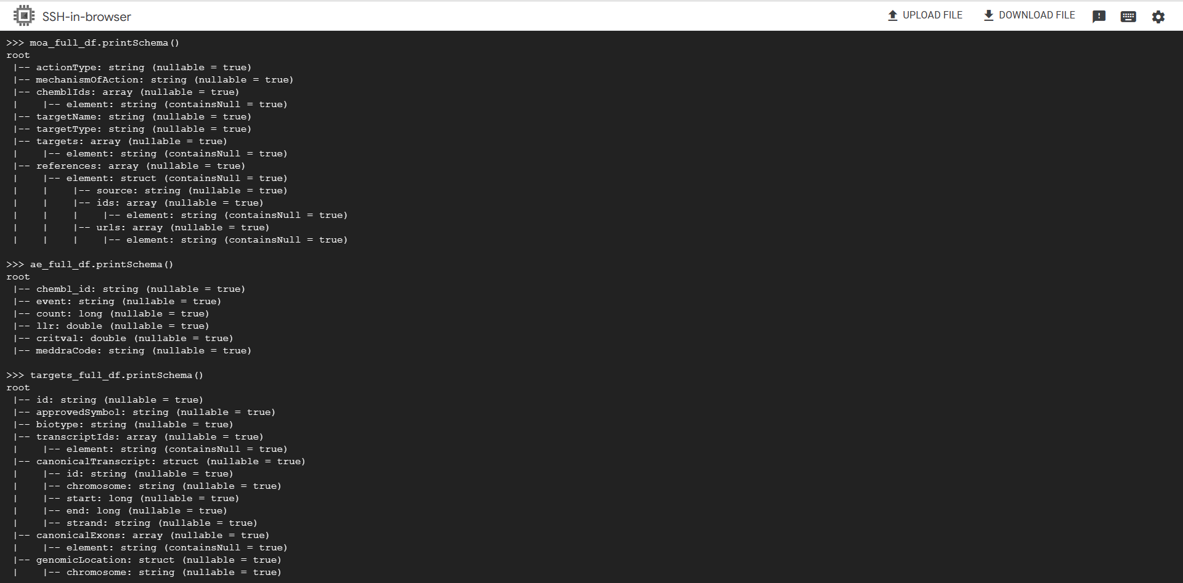

Slide 18
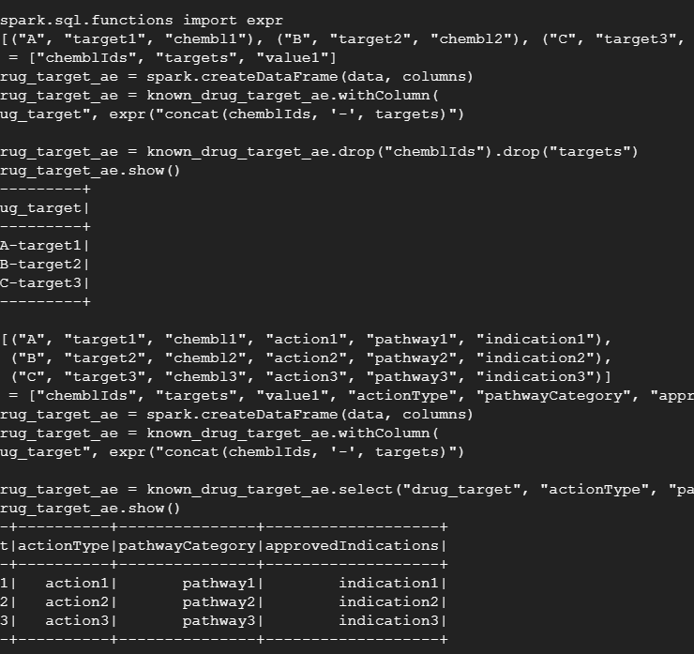
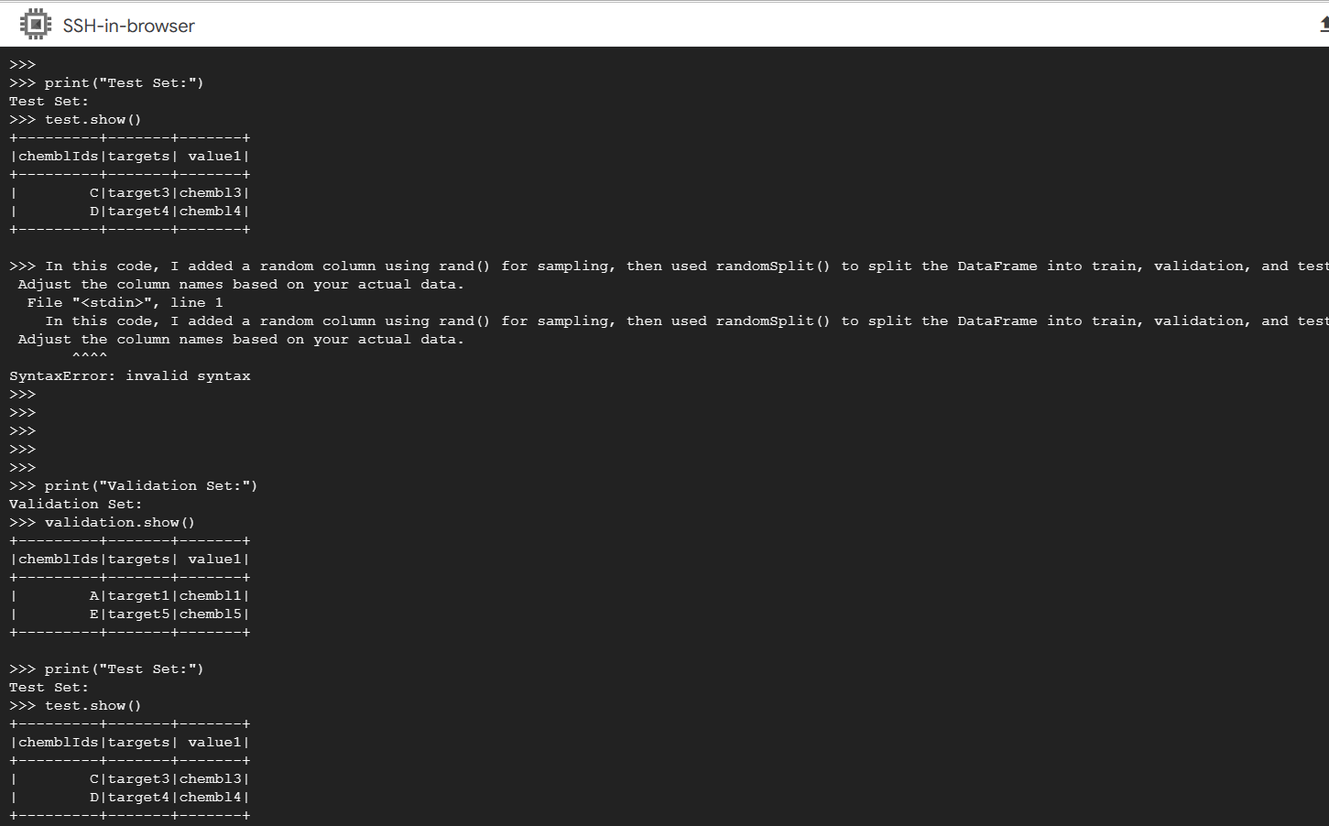

Slide 19
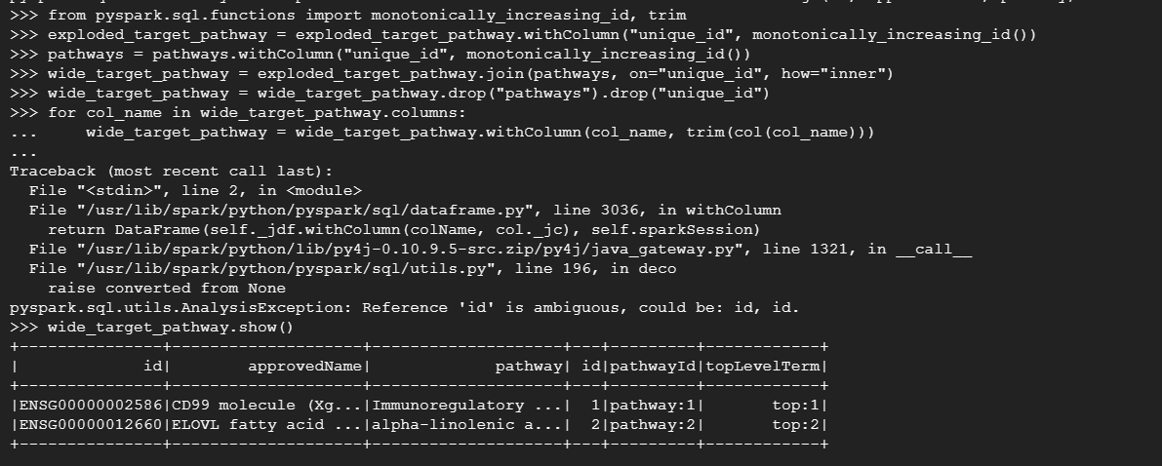
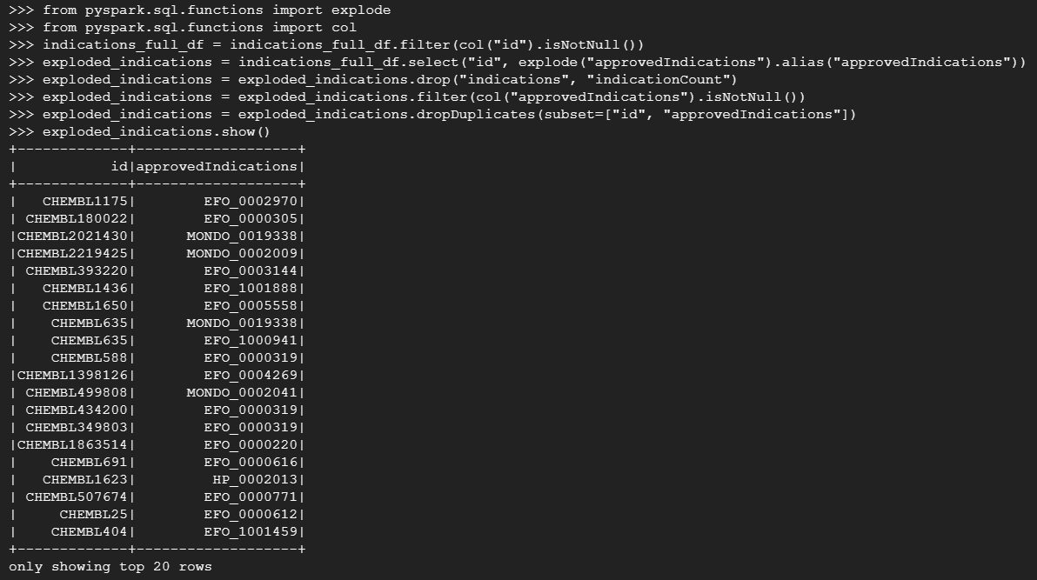

Slide 20
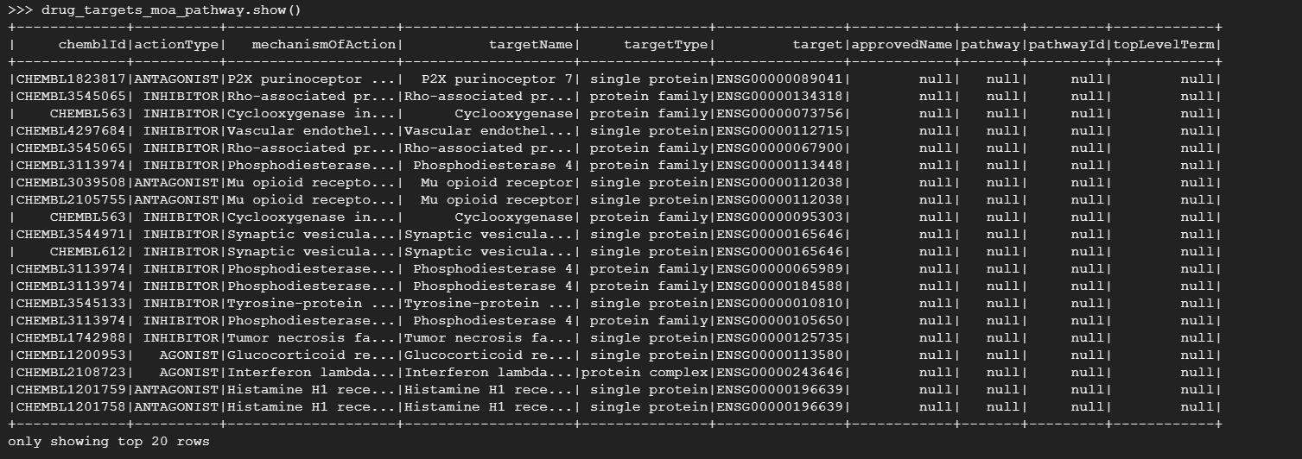

Slide 21
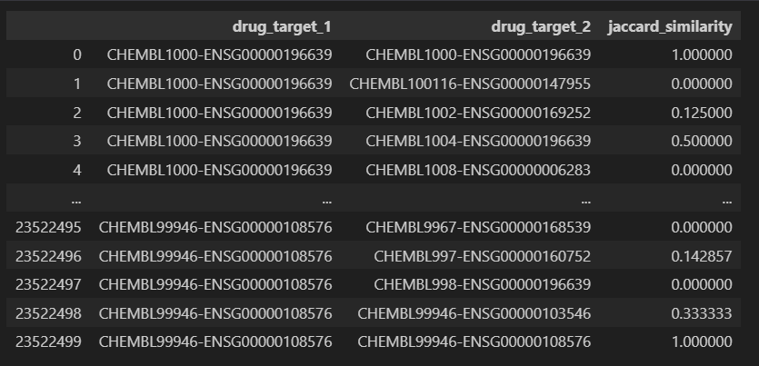
Results

Slide 22
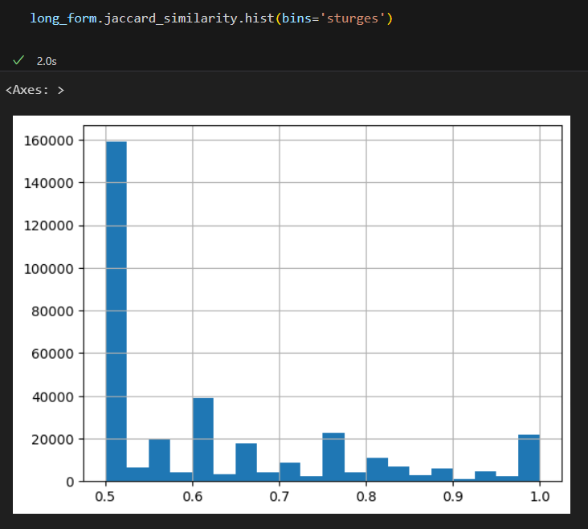
Visualization

Slide 23
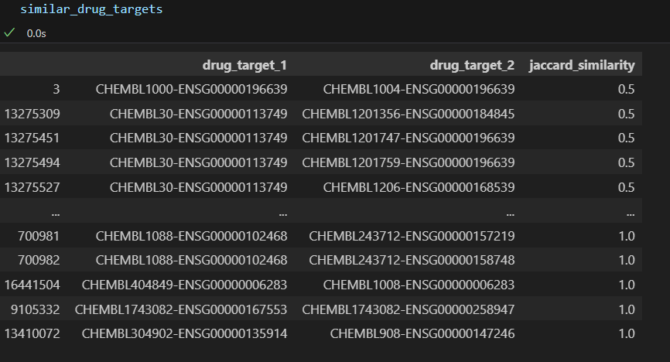
Similarity Score for 2 drugs

Slide 24
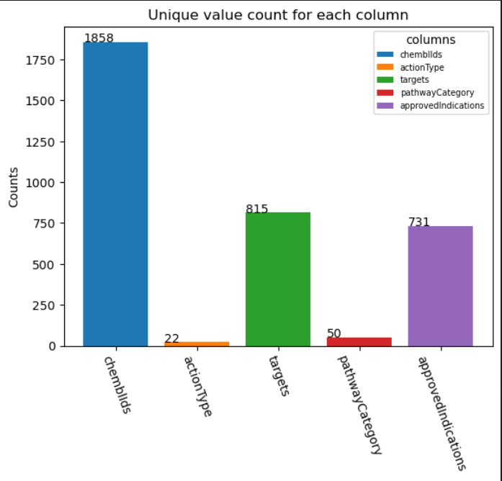
Unique Counts

Slide 25
References
venturebeat.com/business/ai-in-health-care-creates-unique-data-challenges/
https://www.ncbi.nlm.nih.gov/pmc/articles/PMC10302550/#:~:text=AI%20tools%20have%20the%20potential,efficacy%20of%20potential%20drug%20candidates.
https://www.ebi.ac.uk/training/online/courses/chembl-quick-tour/what-is-chembl/#:~:text=ChEMBL%20is%20a%20'chemogenomic'%20database,information%20into%20effective%20new%20drugs.
https://www.projectpro.io/article/hadoop-explained-how-does-hadoop-work-and-how-to-use-it/237
https://www.databricks.com/glossary/what-is-apache-spark
https://www.databricks.com/glossary/apache-hive
https://www.ibm.com/topics/apache-kafka

Slide 26

Questions

